Slide 1
Session 10
Chapter 4 – High-level Database model
Design Principles & ERD to relational model
Database Systems

Slide 2
Objectives
1
Understand design principles
2
Understand constraints in ERDs
3
Know how to convert from ERD to relational designs

Slide 3
Contents
1
Design Principles
2
From ERDs to relational designs

Slide 4
4.2. Design Principles
Faithfulness
Avoid redundancy.
Simplicity Counts
Choose the Right Relationships
Picking the Right Kind of Element
Limit the use of weak entity sets.
Don’t use an entity set when an attribute will do.

Slide 5
4.2.1. Faithfulness
The design should be faithful to the specifications of the application
This means that:
  Entity Sets and their attributes should reflect the reality
    E.g. Attribute StudentID should be assign to Students, not for Products.
  Relationships should make sense given what we know about the part of the real world being modeled.
    E.g. relationships Studies between Students and Courses should be a many-many relationship

Slide 6
4.2.2. Avoiding Redundancy
Redundancy = saying the same thing in two (or more) different ways.
Wastes space and (more importantly) encourages inconsistency.
  Two representations of the same fact become inconsistent if we change one and forget to change the other (update-anomaly).

Slide 7
Example: Bad
name
name
addr
ManfBy
Beers
Manfs
manf
This design states the manufacturer of a beer twice: as an attribute and as a related entity.

Slide 8
Example: Good
name
name
addr
ManfBy
Beers
Manfs
This design gives the address of each manufacturer exactly once.

Slide 9
4.2.3. Simplicity Counts
Avoid introducing more elements into your design than is absolutely nessessary.

Slide 10
Example: A poor design with an Un-necessary entity set
Represents
Movies
Holdings
Owns
Studios
Instead of a relationship between Movies and Studios, the design postulated the existence of “movie-holdings” – the ownership of a single movie
That diagram truly represents the real world, since it is possible to go from a movie to its unique owning studio via Holdings, however, Holdings serves no useful purpose and we are better off without it. It makes programs that use the Movie-Studio relationship more complicated, waste space and encourages errors

Slide 11
Example: A better design without an Un-necessary entity set
Owns
Movies
Studios

Slide 12
4.2.4. Choosing the Right Relationships
Entity Sets can be connected in various ways by relationships.
Adding to our design every possible relationship is not often a good idea.
Doing so can lead to redundancy, update anomalies and deletion anomalies because the connected pairs or sets of entities for one relationship can be deduced from one or more other relationship

Slide 13
Example: Choosing the Right Relationships
Salary
title
year
name
addr
Contracts
Movies
Stars
Do we need the relationships between Movies and Studios and Movies and Stars directly?
What if a star can work on a movie without there being a contract?
length
genre
Studios
name
addr

Slide 14
4.2.5. Picking the Right Kind of Element
Sometimes we have many options regarding the type of design element used to represent a real-world concepts. E.g. between using attributes and using Entity set / Relationship combinations.
In general, an attribute is simpler to implement than either an Entity set or a Relationship

Slide 15
4.2.5. Picking the Right Kind of Element
Entity Sets Versus Attributes
An entity set should satisfy at least one of the following conditions:
  It is more than the name of something; it has at least one nonkey attribute.
  or
  It is the “many” in a many-one or many-many relationship.

Slide 16
Example: Good
name
name
addr
ManfBy
Beers
Manfs
Manfs deserves to be an entity set because of the nonkey attribute addr.
Beers deserves to be an entity set because it is the “many” of the many-one relationship ManfBy.

Slide 17
Example: Bad
name
name
name
manf
ManfBy
Beers
Manfs
Beers
Since the manufacturer is nothing but a name, and is not at the “many” end of any relationship, it should not be an entity set.

Slide 18
4.2.6. Don’t Over-use Weak Entity Sets
Beginning database designers often doubt that anything could be a key by itself.
  They make all entity sets weak, supported by all other entity sets to which they are linked.
In reality, we usually create unique ID’s for entity sets.
  Examples include social-security numbers, automobile VIN’s etc.

Slide 19
4.2.7. When Do We Need Weak Entity Sets?
The usual reason is that there is no global authority capable of creating unique ID’s.
Sometimes, an Entity Set falls into a hierarchy

Slide 20
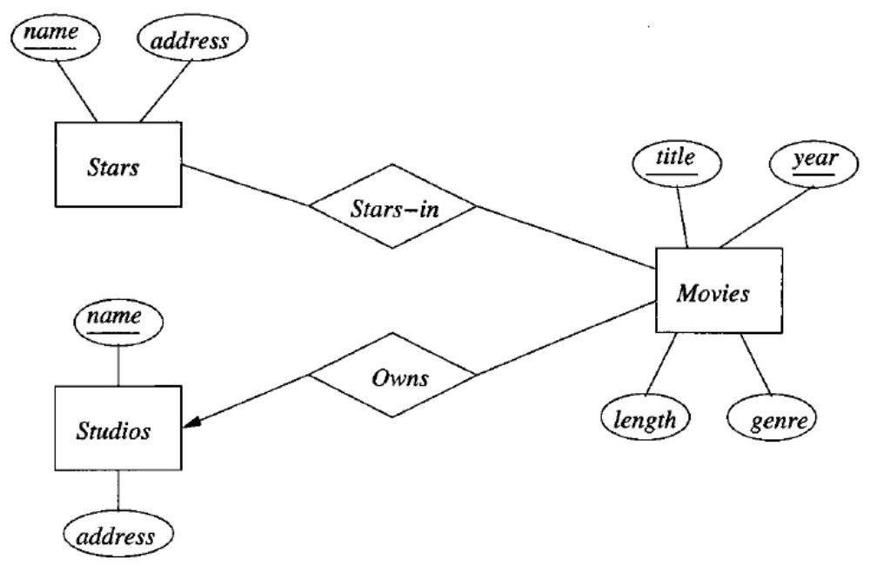
4.3. Constraints in the E-R model
Representing Keys in the E/R Model: underline the attributes belonging to the primary key

Slide 21
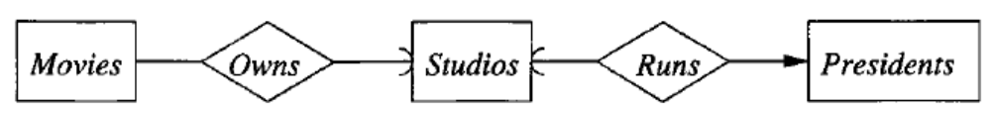
4.3. Constraints in the E-R model
Referential Integrity: using rounded arrowhead pointing to the entity set which is required to exist.
Every movie must be owned by a studio that exists in the Studios entity set
Every president must run a studio that exists in the Studios entity set
Each studio has at most one president, but might have to president at some time.

Slide 22
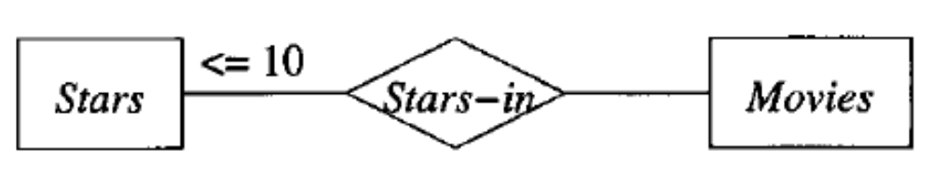
4.3. Constraints in the E-R model
Degree Constraints: attach a bounding number to the edge that connect a relationship to an entity set indicating the limit on the number of entities that can be connected to any one entity of the related entity set..
Each movie cannot be connected by relationship Stars-in to more than 10 stars.

Slide 23
4.4. From E/R diagrams to Relational Designs
Step 1: Turn each non-weak entity set into a relation with the same name and the same set of attributes
Step 2: Replace a relationship by a relation with the same name and its attributes are the keys of connected entity sets
Step 3: Create relations for weak entity sets and subclasses
Step 4: Sometimes, we do combine two relations, especially the relation comes from a many-one relationship and from a related entity set
Step 5: Ensure that the tables are in 2NF or 3NF.

Slide 24
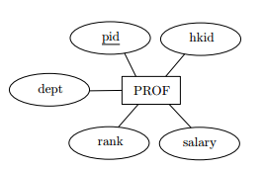
Convert non-weak entity set
Entity set => relation of the same name, with the same set of attributes and same primary key
PROF(pid, hkid, dept, rank, salary)
Where pid is set as a candidate key

Slide 25
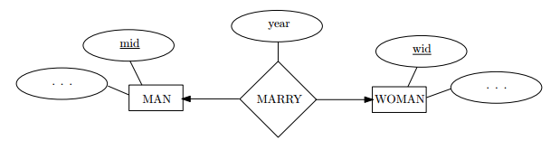
Convert one-one relationship
One-one relationship:
New table that has two candidate keys.
MARRY(mid, wid, year): candidate key is mid or wid
- mid is foreign key references to MAN(mid)
- wid is foreign key references to WOMAN(mid)

Slide 26
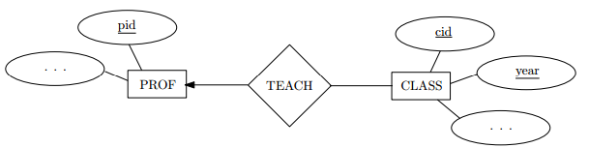
Convert one-many relationship
PROF(pid, …) - candidate key is pid
CLASS(cid, year, …, pid) – candidate key is (cid, year) and pid is foreign key references to PROF(pid)

Slide 27
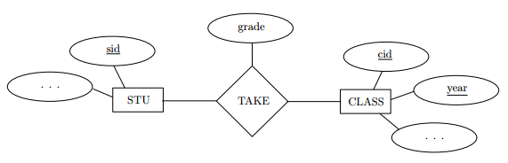
Convert many-many relationship
STU(sid, …) - candidate key is sid
CLASS(cid, year, …, pid) – candidate key is (cid, year)
TAKE(sid, cid, year, grade) – candidate key is (sid, cid, year) and
- foreign key sid references to STU(sid)
- foreign key (cid, year) references to CLASS(cid, year)

Slide 28
Convert multi-way relationship
Salary
title
year
name
sid
Contracts
Movies
Stars
length
genre
Studios
name
addr
MOVIES(title, year, length genre) - candidate key is (title, year)
STARS(sid, name) – candidate key is sid
STUDIOS(name, address) – candidate key is name
CONTRACTS(sid, title, year, studio-name, salary) – candidate key is (sid, title, year) and
- foreign key sid references to STARS(sid)
- foreign key (title, year) references to MOVIES(title, year)
- foreign key studio-name references to STUDIOS(name)

Slide 29
Convert weak entity
name
number
name
address
Players
Plays-
on
Teams
TEAMS(name, address) - candidate key is name
PLAYERS(number, team-name, name) – candidate key is (number, team-name) and
- foreign key team-name references to TEAMS(name)

Slide 30
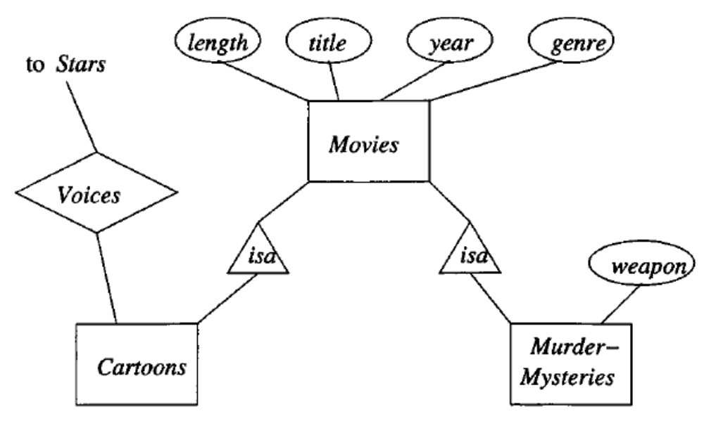
Convert subclass structures
There are three strategy for conversion to relations:
E/R style conversion
An Object-oriented approach
Using null values to combine relations

Slide 31
Convert sub-class structures
E/R-style conversion
MOVIES (title, year, length, genre)
MURDERMYSTERIES(title, year, weapon)
CARTOONS(title, year)
Movies relation has every movie.
Movies that are murder mysteries have a tuple in both Movies and Murder-Mysteries relations.
Movies that are cartoons have a tuple in both Movies and Cartoons relations.
Movies that are both cartoons and murder mysteries have a tuple in all the three relations.

Slide 32
Convert sub-class structures
An Object oriented approach
MOVIES (title, year, length, genre)
MOVIESC (title, year, length, genre)
MOVIESMM (title, year, length, genre, weapon)
MOVIESCMM (title, year, length, genre, weapon)
This approach enumerate all the possible sub-trees of hierarchy.
For each, create one relation that represents entities having components in exactly those sub-trees.

Slide 33
Convert sub-class structures
Using Null values to combine relations
In this approach, there is only one relation that has all attributes belonging to any entity set of the hierarchy.
Tuple has Null in each attribute that is not defined for appropriate entity.
MOVIES (title, year, length, genre, weapon)
Candidate key of all relations are the same – (title, year)

Slide 34
Step 5: The questions to Ensure that the tables are in 3NF
Does the table contain any repeating groups?
If not, and the table has a primary key then it is First normal form (1NF)
Does the table contain any partial dependencies?
If not, and it is in 1NF then it is in 2NF
Does the table contain any transitive dependencies or derived attributes?
If not, and it is in 2NF then it is in 3NF

Slide 35





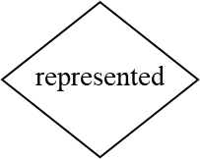













Example: Convert this ERD to Relational Design
Presenter
Agent
Show
ProdComp

Slide 36
Example: Convert this ERD to Relational Design
AGENT(aName, cName, city, phone)
PRESENTER(SIN, fName, IName, hair, aName, cName)
SHOW(sName, station, season, pcName)
PRODCOMP(pcName, netWorth, country)
PRESENTS(SIN, sName, times, rating)

Slide 37
Thank You !

